Slide 1
YOLO-based Car Object Detection
Oheneba, Anil, Aidan

Slide 2
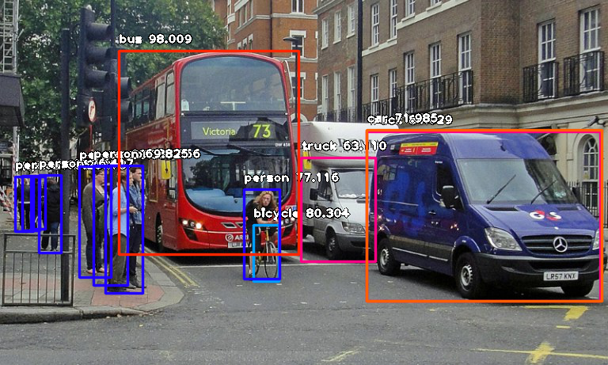
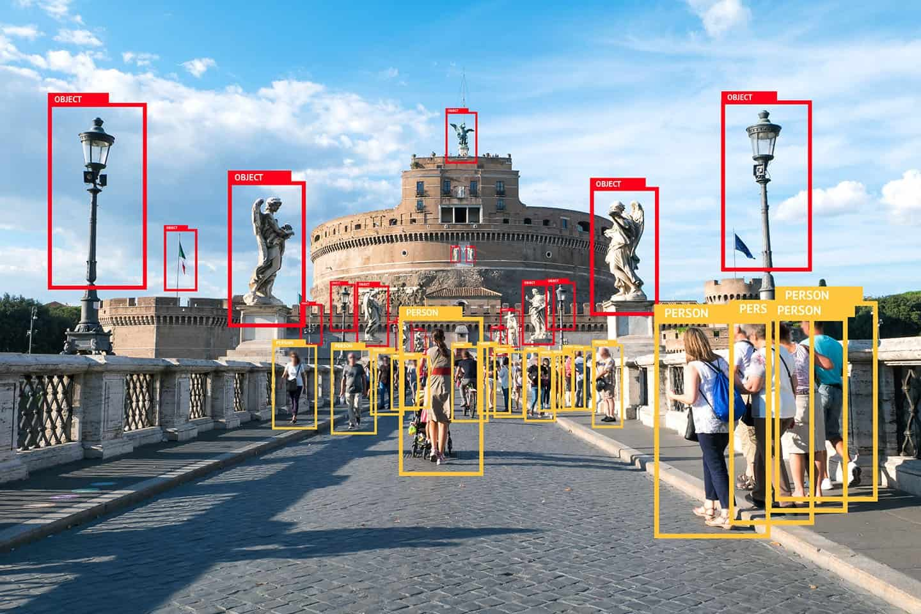
Introduction
The YOLO (You Only Look Once) algorithm has revolutionized the field of object detection by delivering high accuracy while maintaining real-time performance.
Its ability to process images rapidly and efficiently makes it an ideal candidate for detecting cars in various views.
We analyze the potential applications of a YOLO-based deep learning model utilizing a car dataset for traffic recognition, with the aim of improving traffic management and safety.

Slide 3
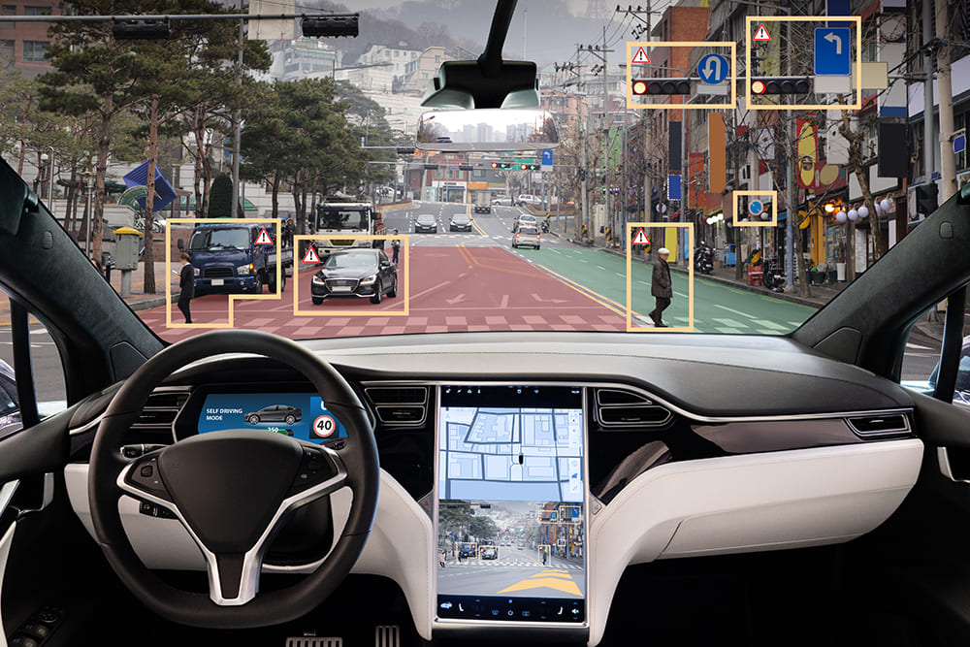
Application in Traffic Recognition
Alerting passengers and passersby of incoming traffic: Sends alerts to pedestrians and drivers about potential hazards, improving safety in urban environments.
Traffic jam detection and management: Identifies traffic congestion by detecting and analyzing the density of cars in a specific area.
Enhanced driver assistance systems: Adaptive cruise control, collision avoidance, and lane departure warning systems.
Autonomous vehicles: Enhances the accuracy and efficiency of autonomous vehicles' decision-making processes, ensures safer and smoother rides.
Law enforcement and traffic violation detection: Identifies traffic violations

Slide 4
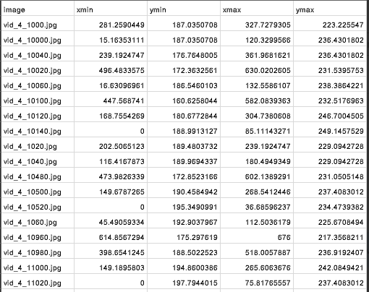
Dataset
We have train and test images collected from Kaggle. There are 355 images in the training dataset and 175 test images.

Slide 5
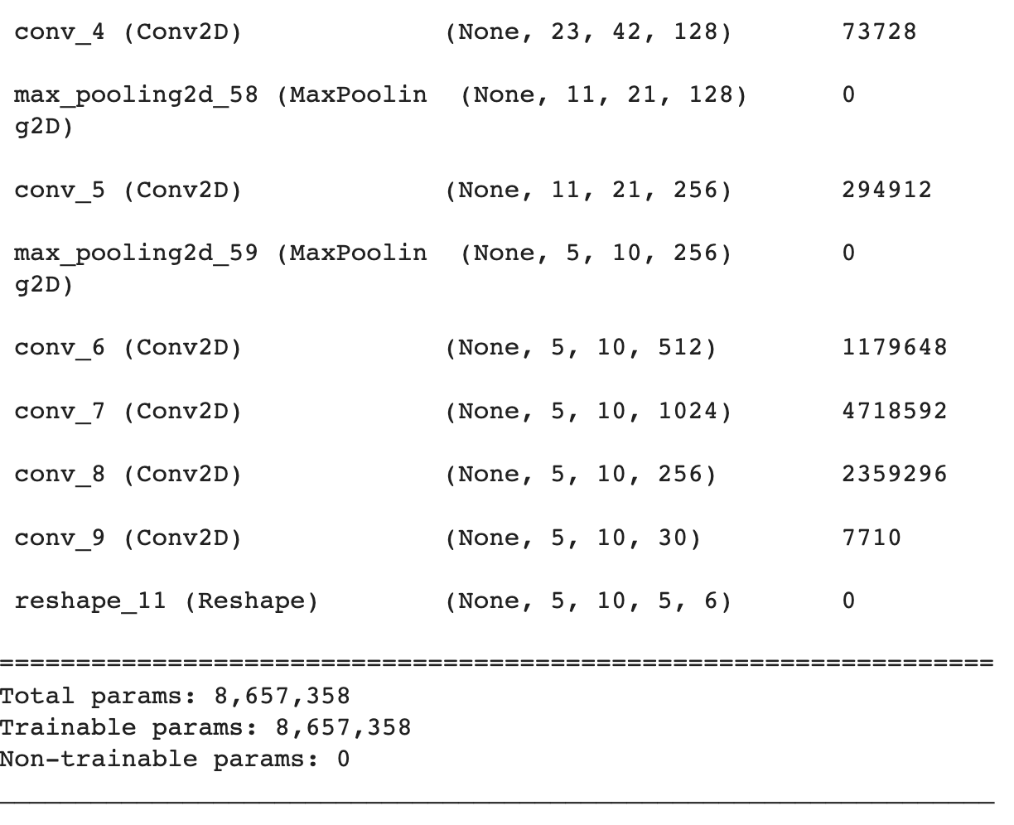
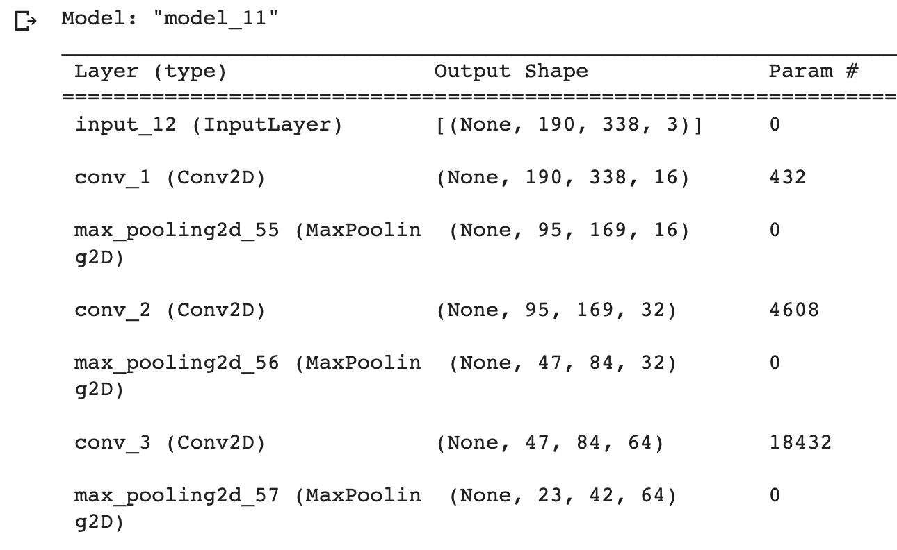
Model Architecture

Slide 6
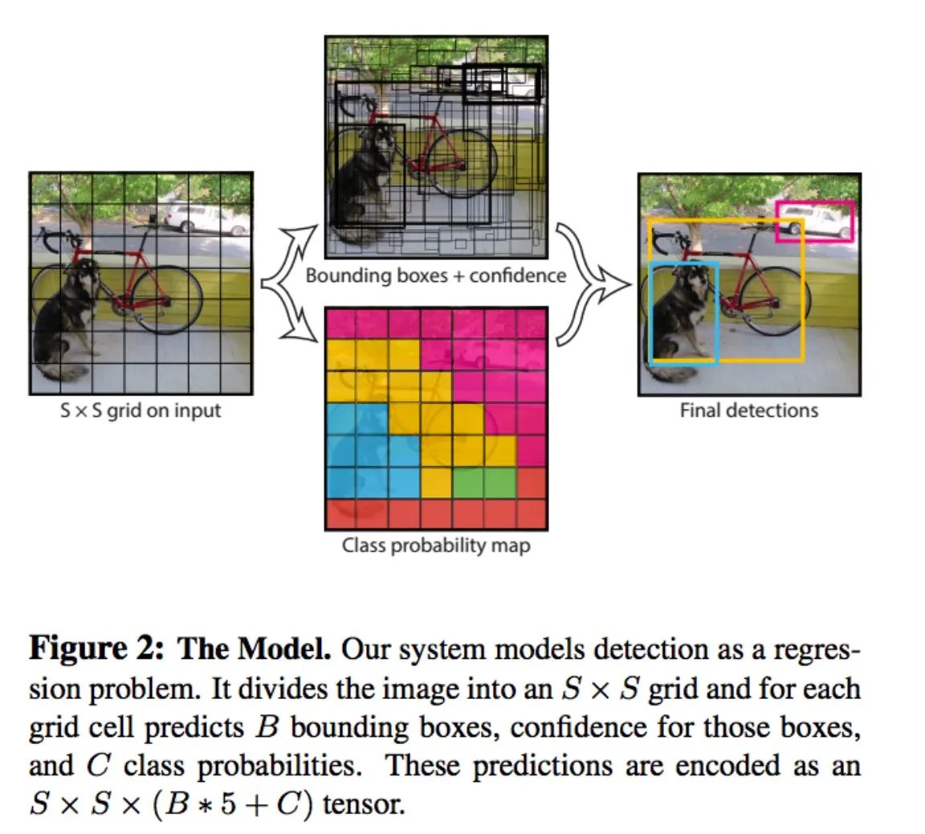
What we’re actually predicting
In our case, each prediction is a tensor of shape (5, 10, 5, 6)
5: grid width
10: grid height
5: max # objects per cell
6: x, y, w, h, objectness, class

Slide 7
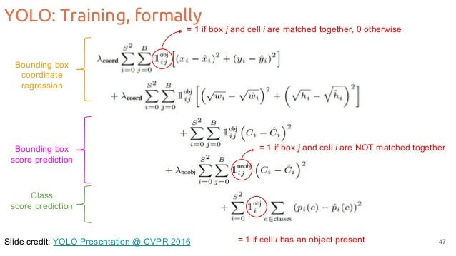
Loss function

Slide 8
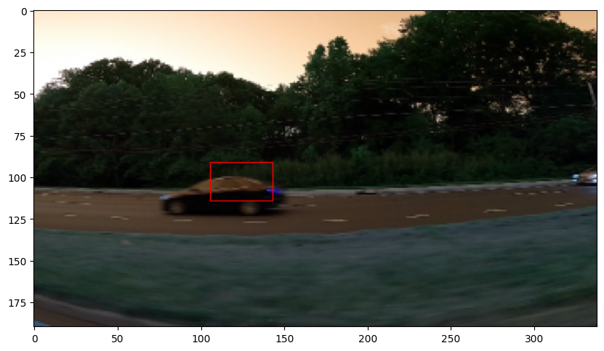
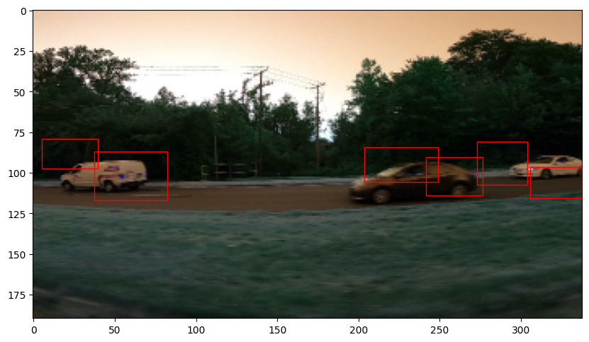
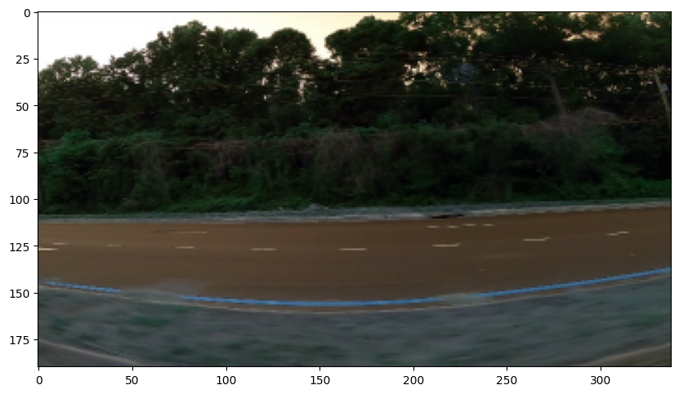
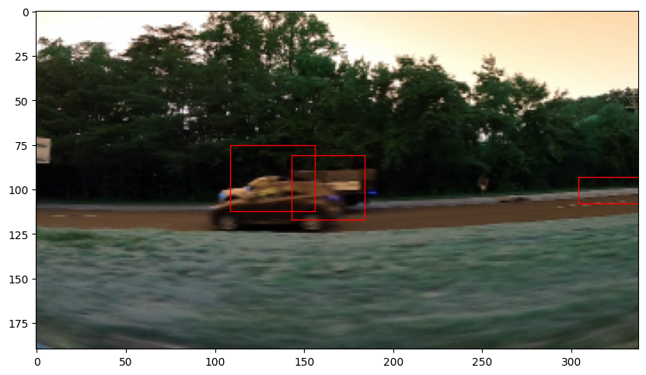
Result

Slide 9
Works Cited
https://medium.com/@ankushsharma2805/yolo-v1-v2-v3-architecture-1ccac0f6206e
https://www.kaggle.com/code/balraj98/yolo-v5-car-object-detection
https://towardsdatascience.com/yolo-you-only-look-once-real-time-object-detection-explained-492dc9230006

Slide 10
Thanks For Listening!

